Slide 1
Database Systems Development
Lecture 1
Introduction to database systems

Slide 2
Agenda
Module description
Terms: Database, Database Management System (DBMS).
Classification of database systems
ANSI-SPARC Three-Level Architecture
Database modelling – ER diagrams

Slide 3
Module description
20 credits core module
Duration - 2 Semesters
All assessments are based on practical pieces of work
  CW1 40% - TW 12
  In class test 20% Sem 2 TW 2
  CW2 40% - Sem2 TW 12

Slide 4
Module structure overview
Relational model, DB general principles
Database design
  Conceptual design (EER)
  Logical design(mapping)
  Functional dependencies, Normalization
Query relational data
  SQL DML and DDL
Procedural features of SQL
Query optimization
Web Interfaces for DB
  ADO.NET, ASP.NET MVC
Database Warehouse introduction

Slide 5
Terms
Database is shared collection of logically related data (and a description of this data), designed to meet the information needs of an organization
Database Management System (DBMS) is a software system that enables users to define, create, and maintain the database and that provides controlled access to this database.

Slide 6
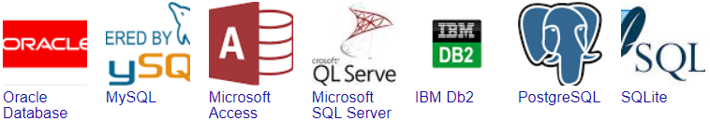







Classification by data model
  Hierarchical and Network IDMS, Win Registry
Relational
Object
Relational
Object Oriented
NoSQL

Slide 7
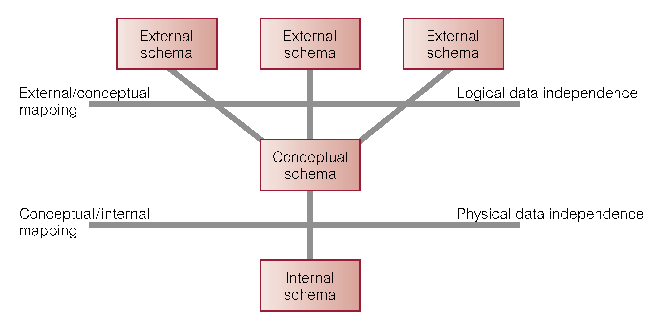
ANSI-SPARC Three-Level Architecture

Slide 8
Database design – ER modelling
ER modelling is a top-down approach to database design that begins by identifying the important data called entities and relationships between the data that must be represented in the model.
Multiple ER notations exists, e.g.:
  Chen’s notation
  Crow’s Foot Notation
  UML

Slide 9
Concepts of the ER model
Entity types
  Strong and weak entity types
Attributes
Relationship types
  Structural Constraints

Slide 10
Entity
Entity type
  Group of objects with same properties, identified by enterprise as having an independent existence.
Entity occurrence
  Uniquely identifiable object of an entity type.

Slide 11
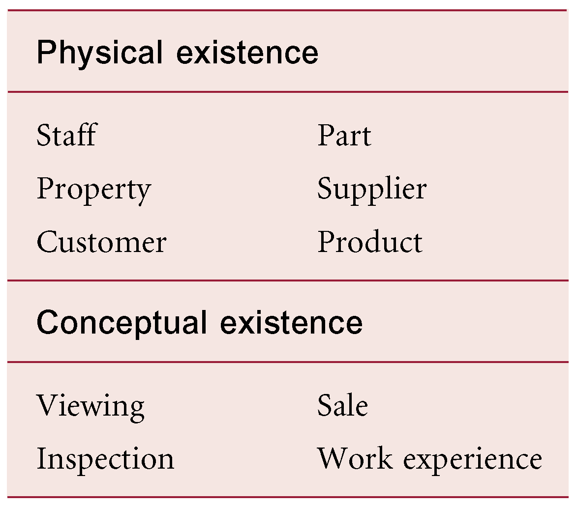
Entity examples

Slide 12
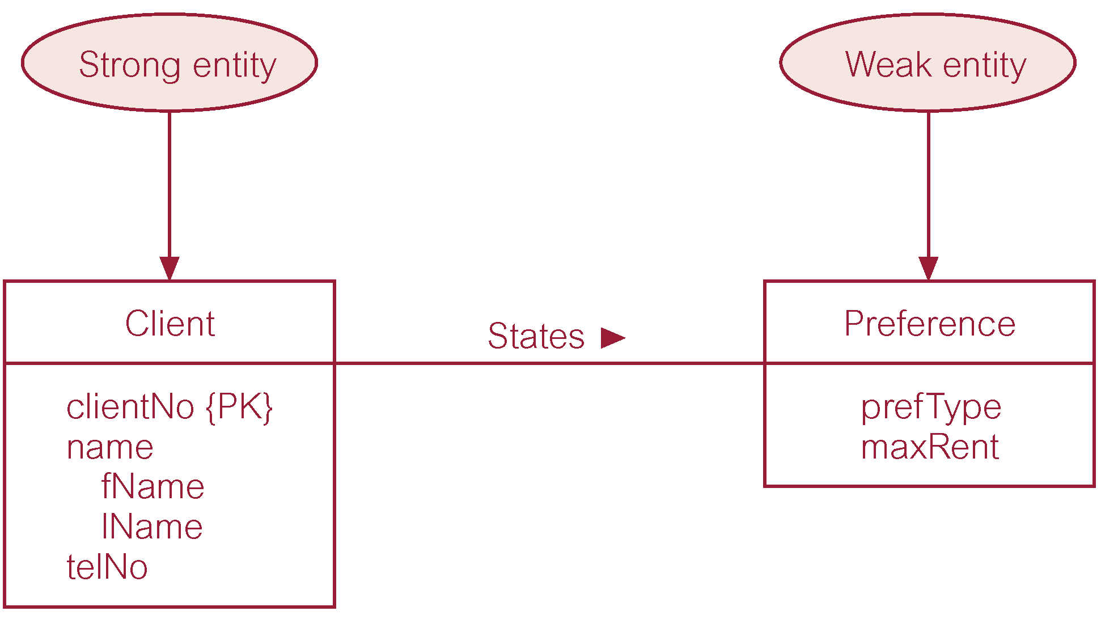
Entity
Strong Entity Type
  Entity type that is not existence-dependent on some other entity type.
Weak Entity Type
  Entity type that is existence-dependent on some other entity type.

Slide 13
Attributes
Attribute
  Property of an entity or a relationship type.
Attribute Domain
  Set of allowable values for one or more attributes.

Slide 14
Attributes
Simple Attribute
  Attribute composed of a single component with an independent existence.
Composite Attribute
  Attribute composed of multiple components, each with an independent existence.
Derived Attribute
  Attribute that represents a value that is derivable from value of a related attribute, or set of attributes, not necessarily in the same entity type.

Slide 15
Attributes
Single-valued Attribute
  Attribute that holds a single value for each occurrence of an entity type.
Multi-valued Attribute
  Attribute that holds multiple values for each occurrence of an entity type.

Slide 16
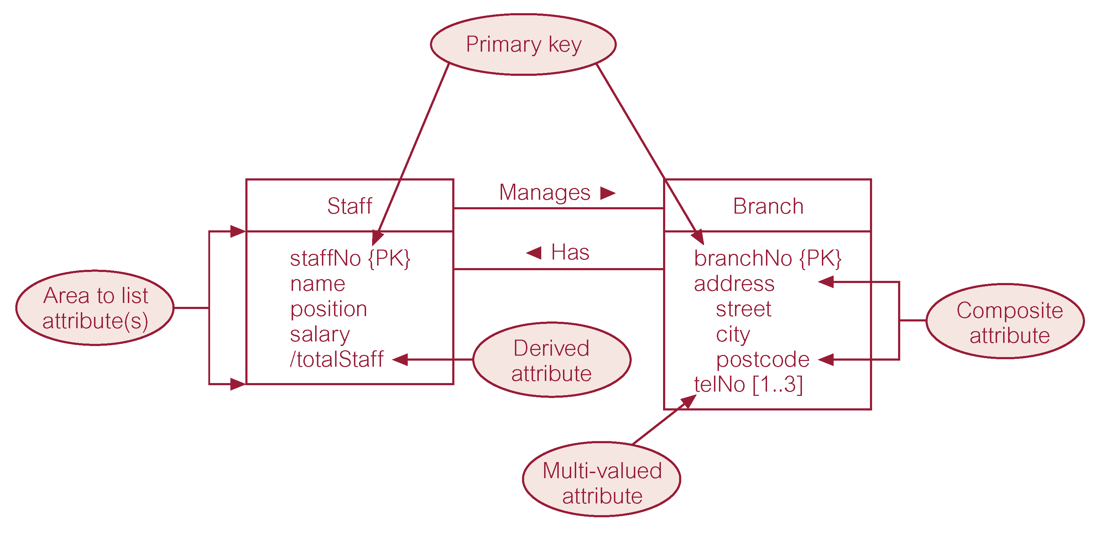
Attributes example

Slide 17
Relationship
Relationship type
  Set of meaningful associations among entity types.
Relationship occurrence
  Uniquely identifiable association, which includes one occurrence from each participating entity type.

Slide 18
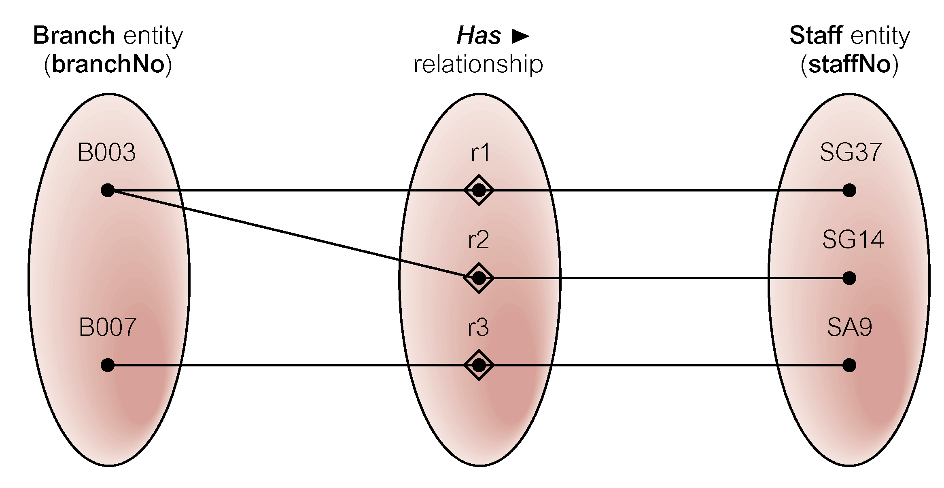
Relationship type and occurrences

Slide 19
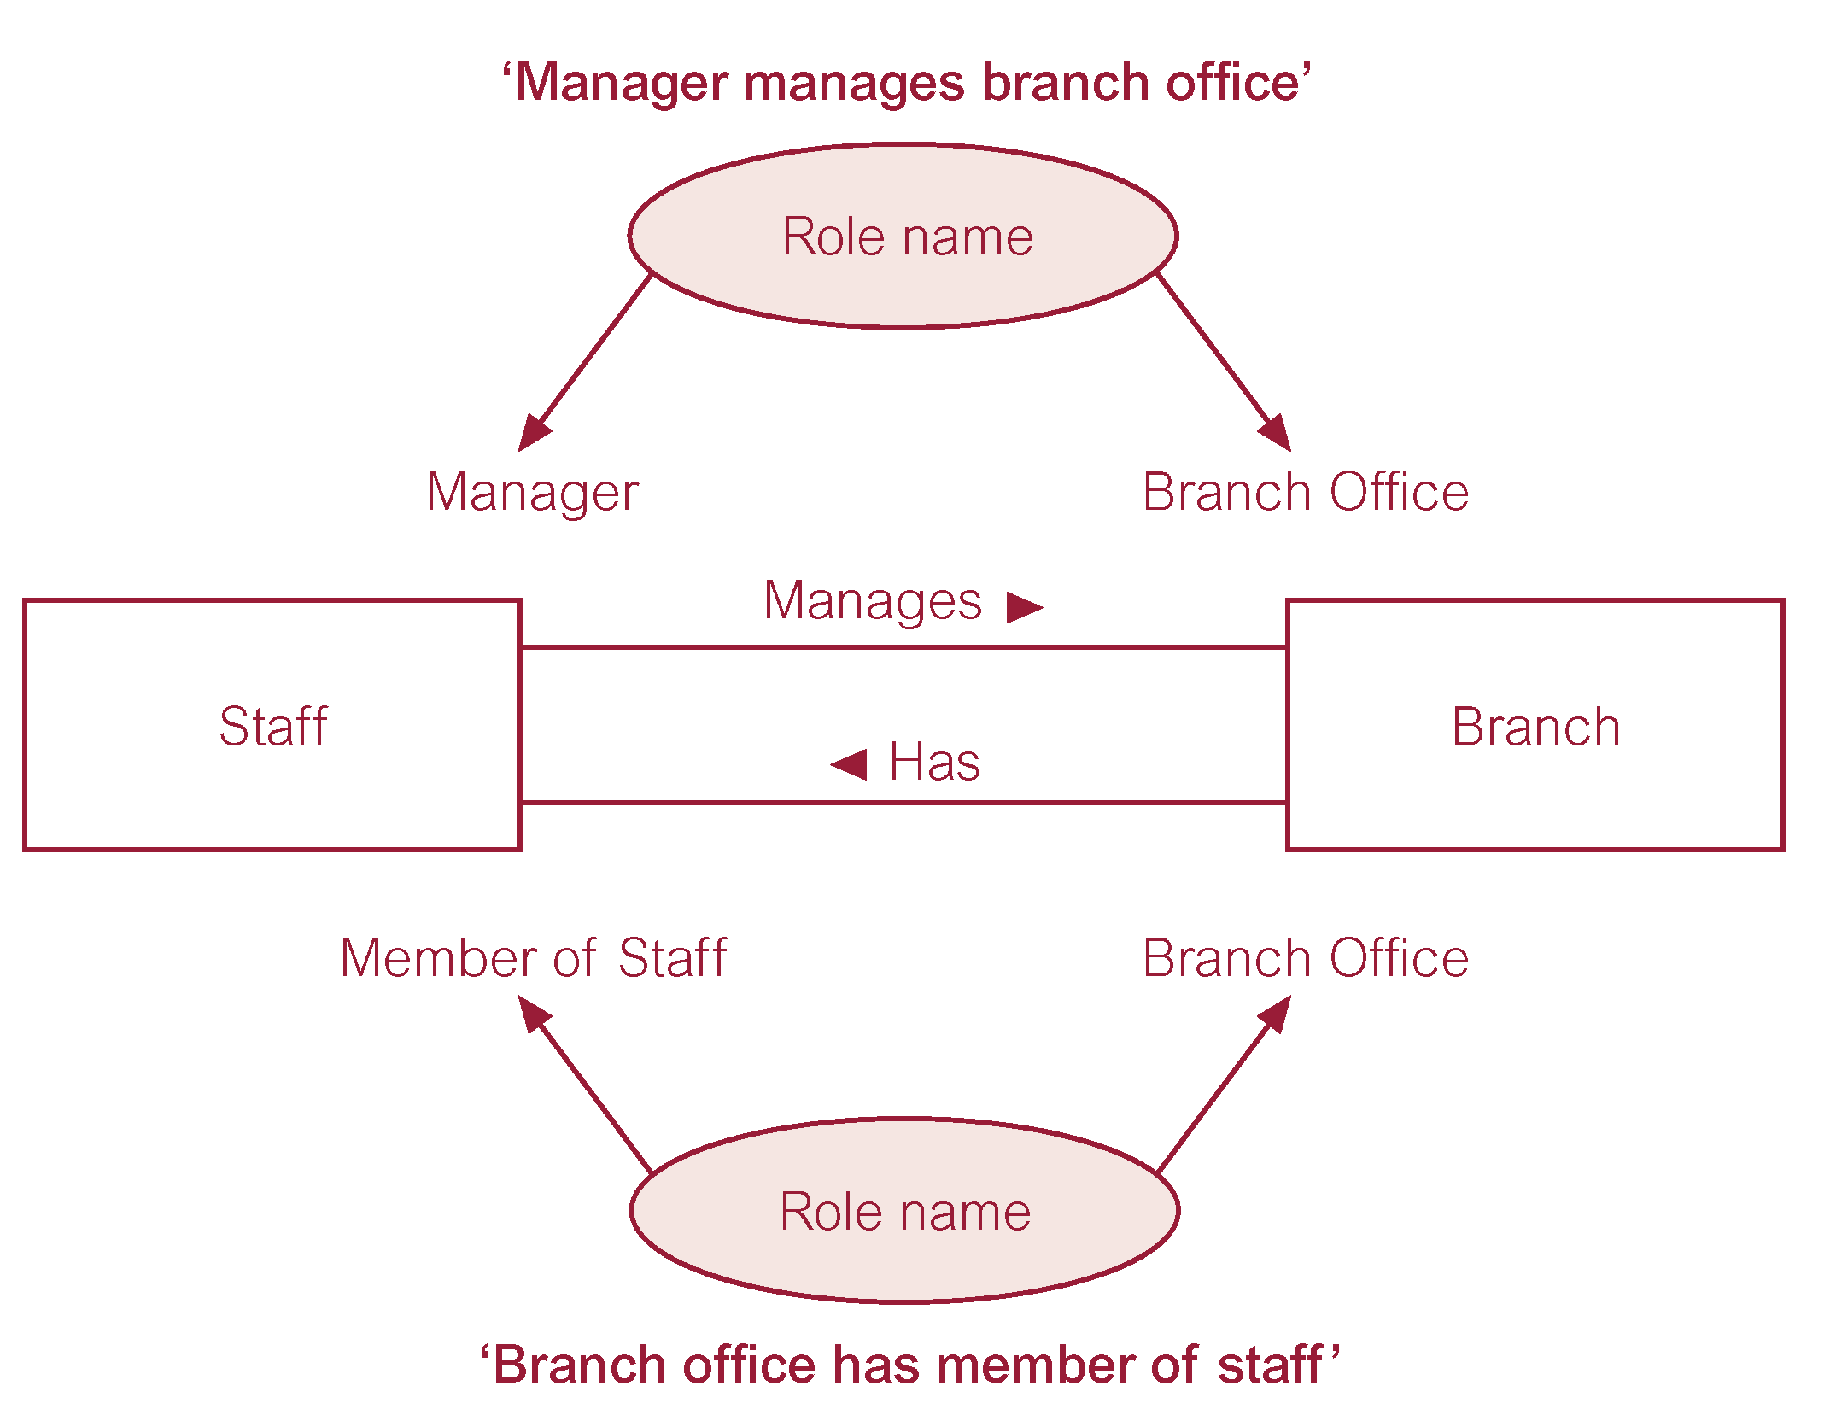
Relationship example

Slide 20
Relationship properties
Degree of a Relationship
  Number of participating entities in relationship.
Relationship of degree:
  two is binary
  three is ternary
  four is quaternary

Slide 21
Structural Constraints
Main type of constraint on relationships is called multiplicity.
Multiplicity – number (or range) of possible occurrences of an entity type that may relate to a single occurrence of an associated entity type through a particular relationship.

Slide 22
Structural Constraints
Multiplicity is made up of two types of restrictions on relationships: cardinality and participation.
Cardinality
  Describes maximum number of possible relationship occurrences for an entity participating in a given relationship type.
Participation
  Determines whether all or only some entity occurrences participate in a relationship.

Slide 23
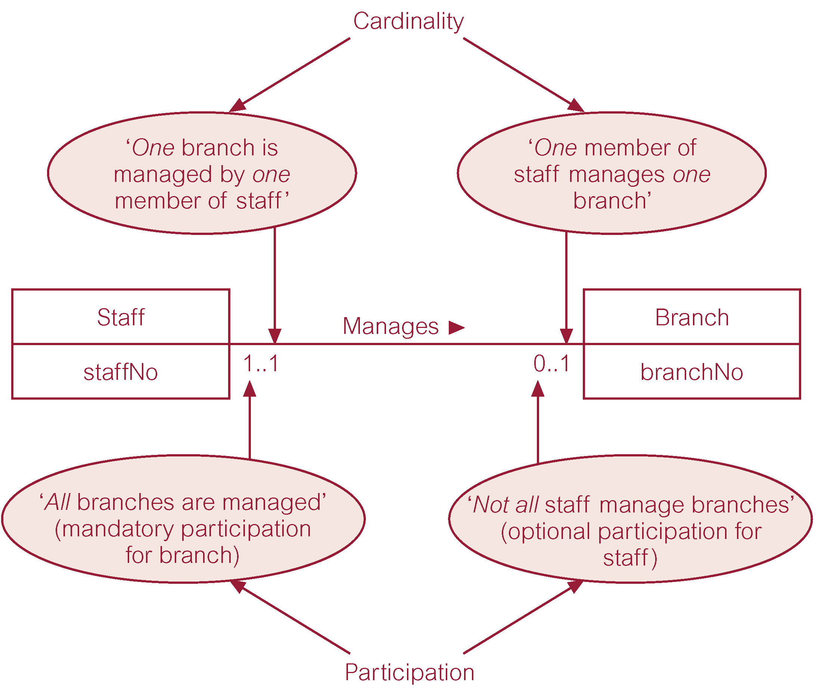
Structural Constraints example

Slide 24
Structural Constraints
The most common degree for relationships is binary.
Binary relationships are generally referred to as being:
  one-to-one (1:1)
  one-to-many (1:*)
  many-to-many (*:*)

Slide 25
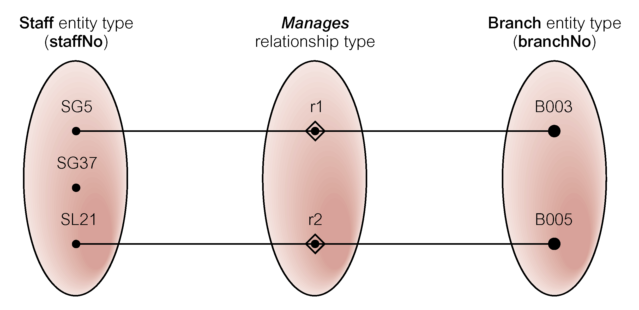
One-to-one relationship (1:1)

Slide 26
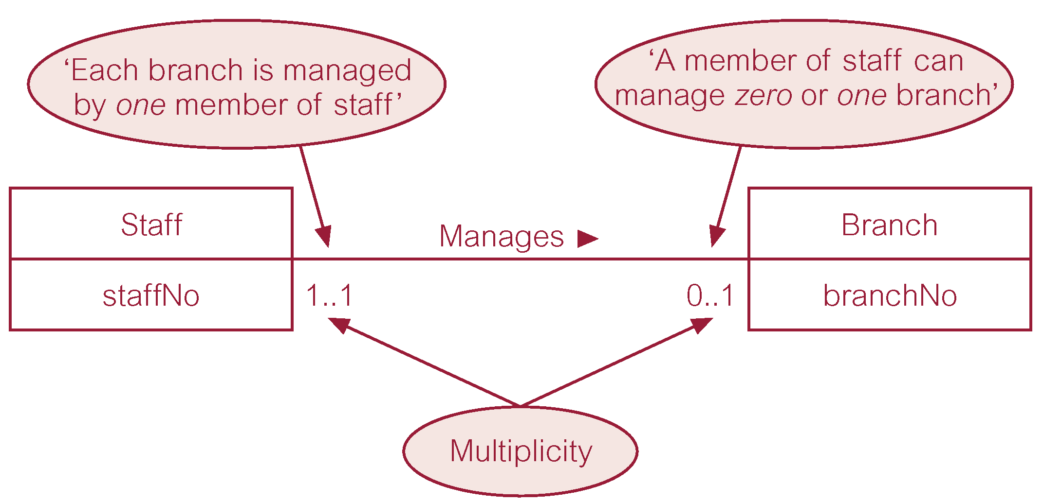
One-to-one relationship (1:1)

Slide 27
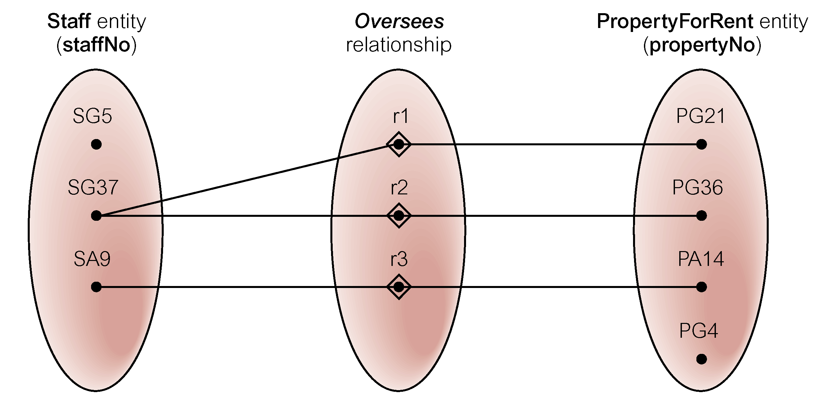
One-to-many relationship (1:*)

Slide 28
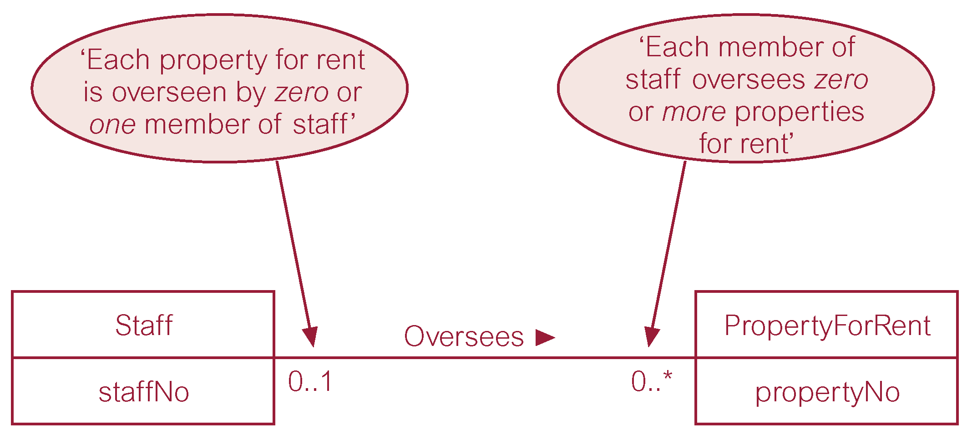
One-to-many relationship (1:*)

Slide 29
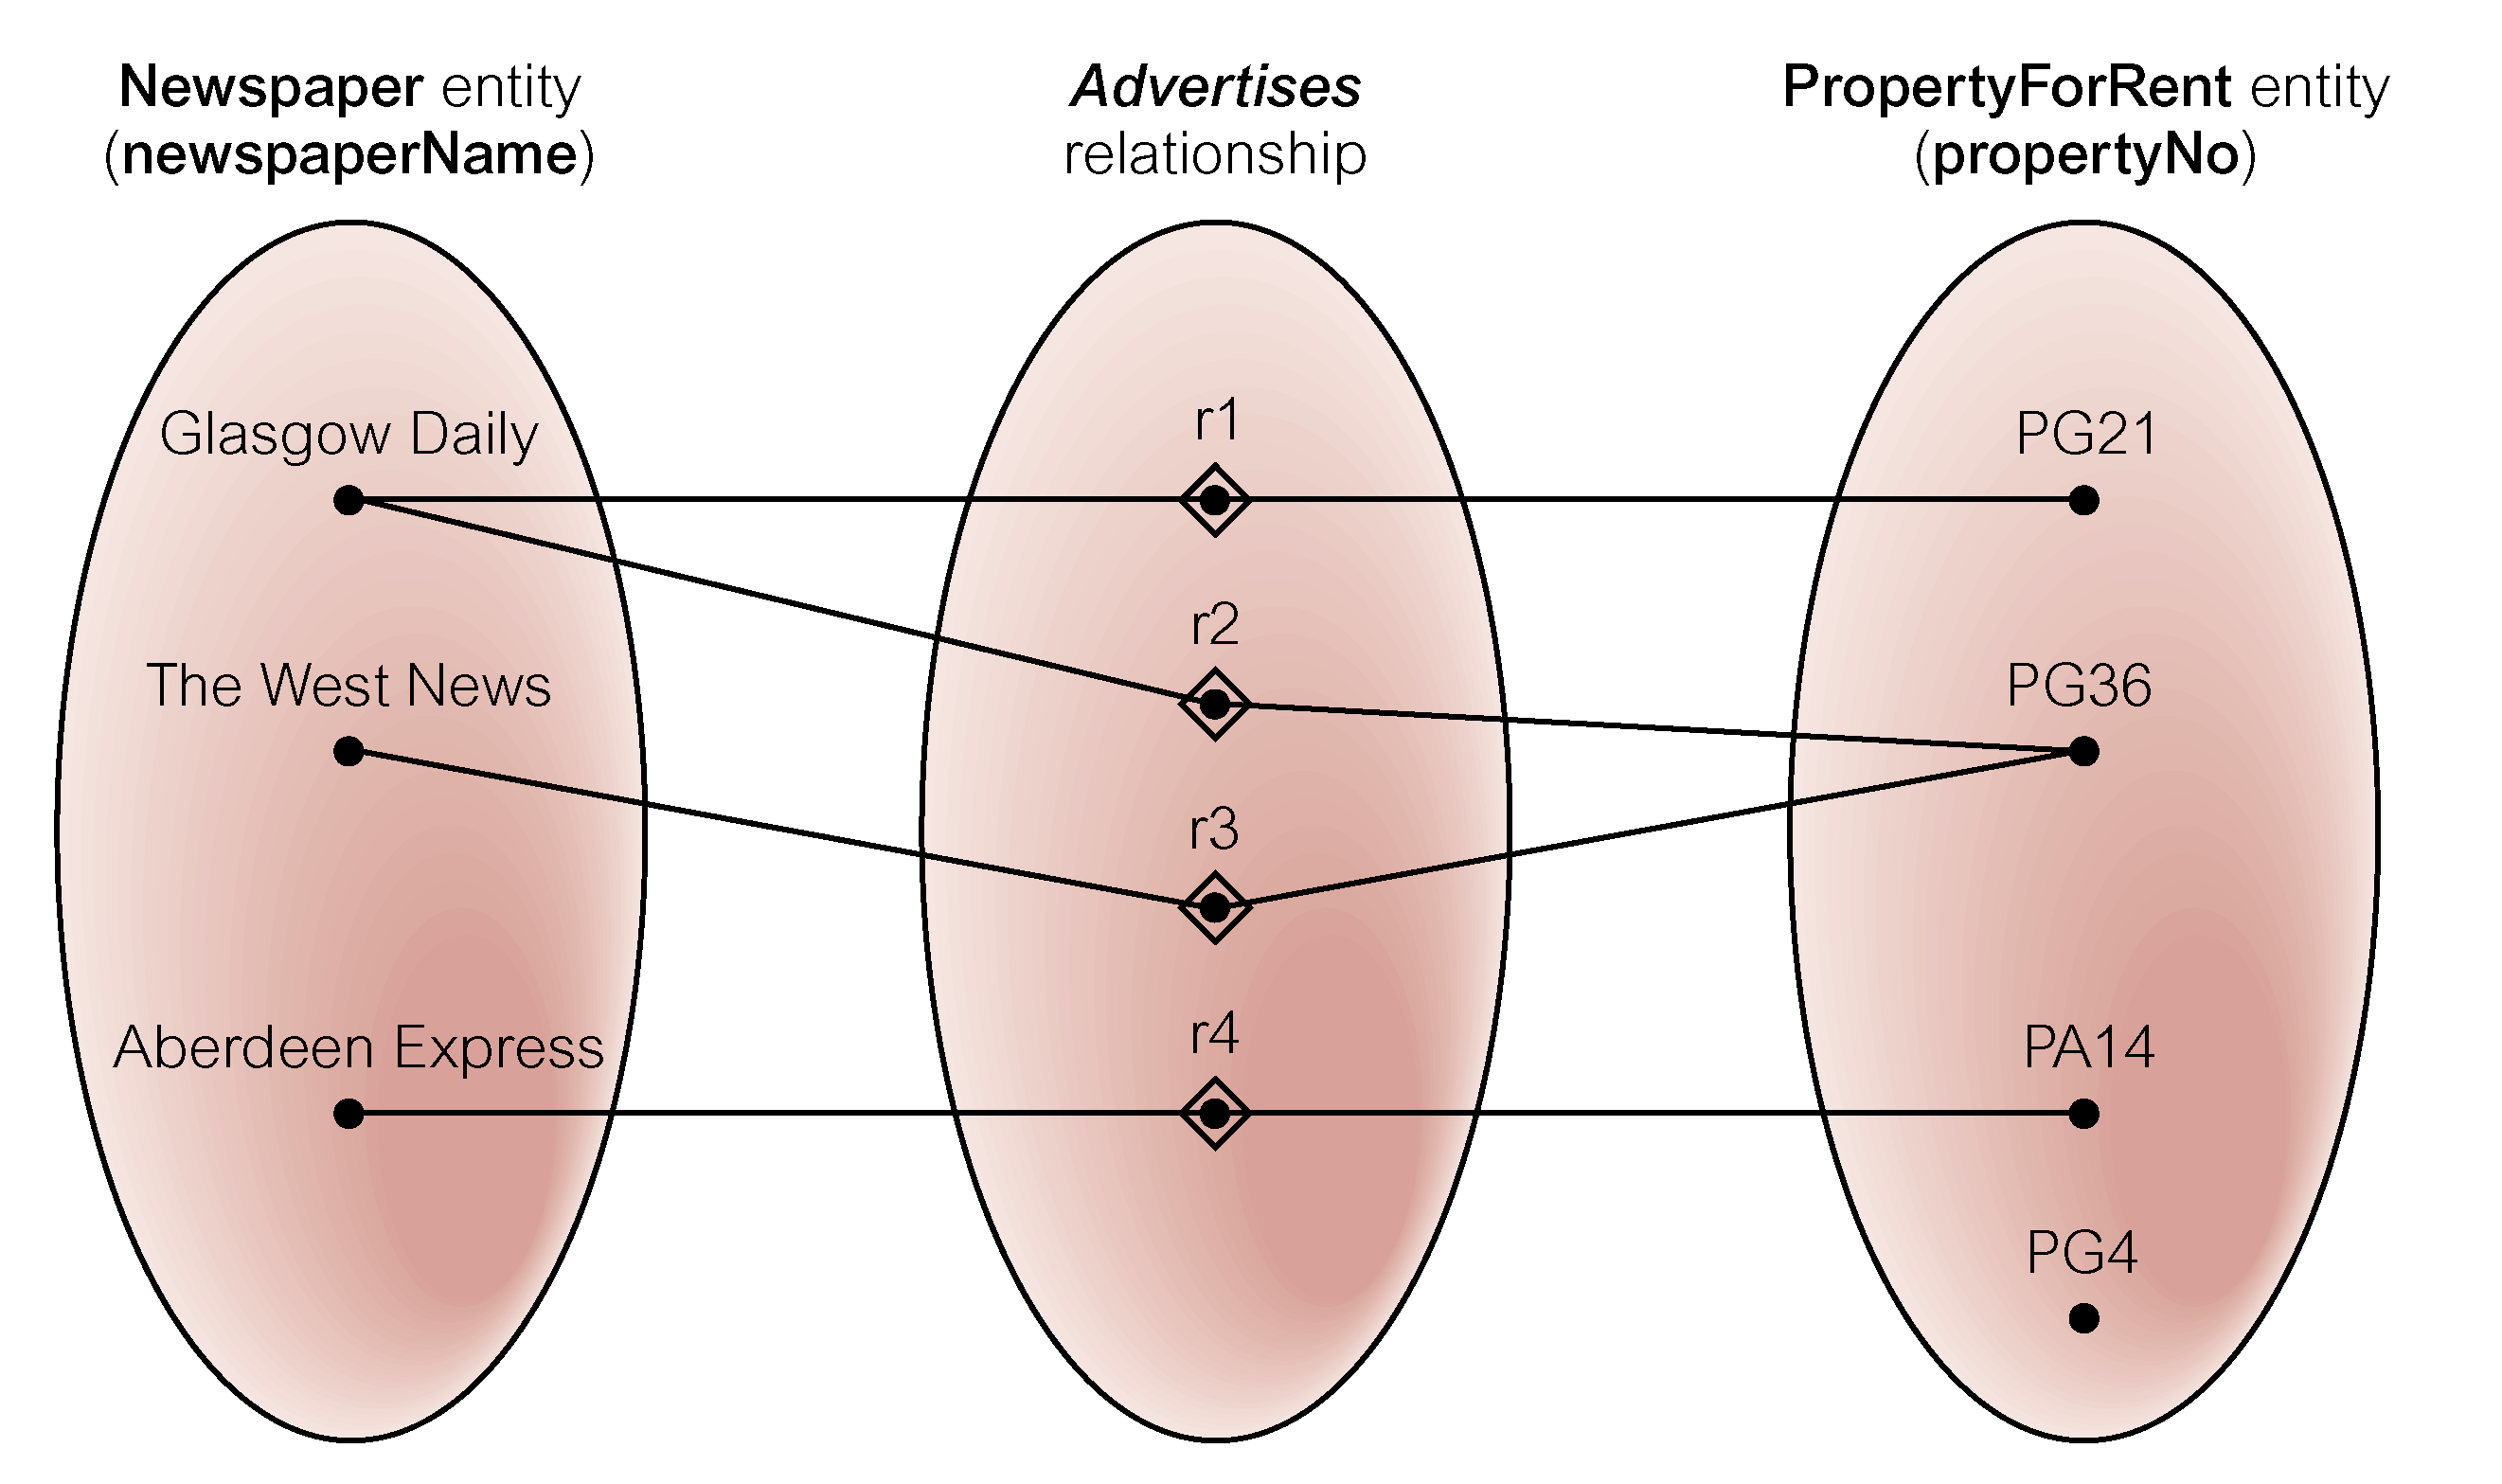
Many-to-many relationship (*:*)

Slide 30
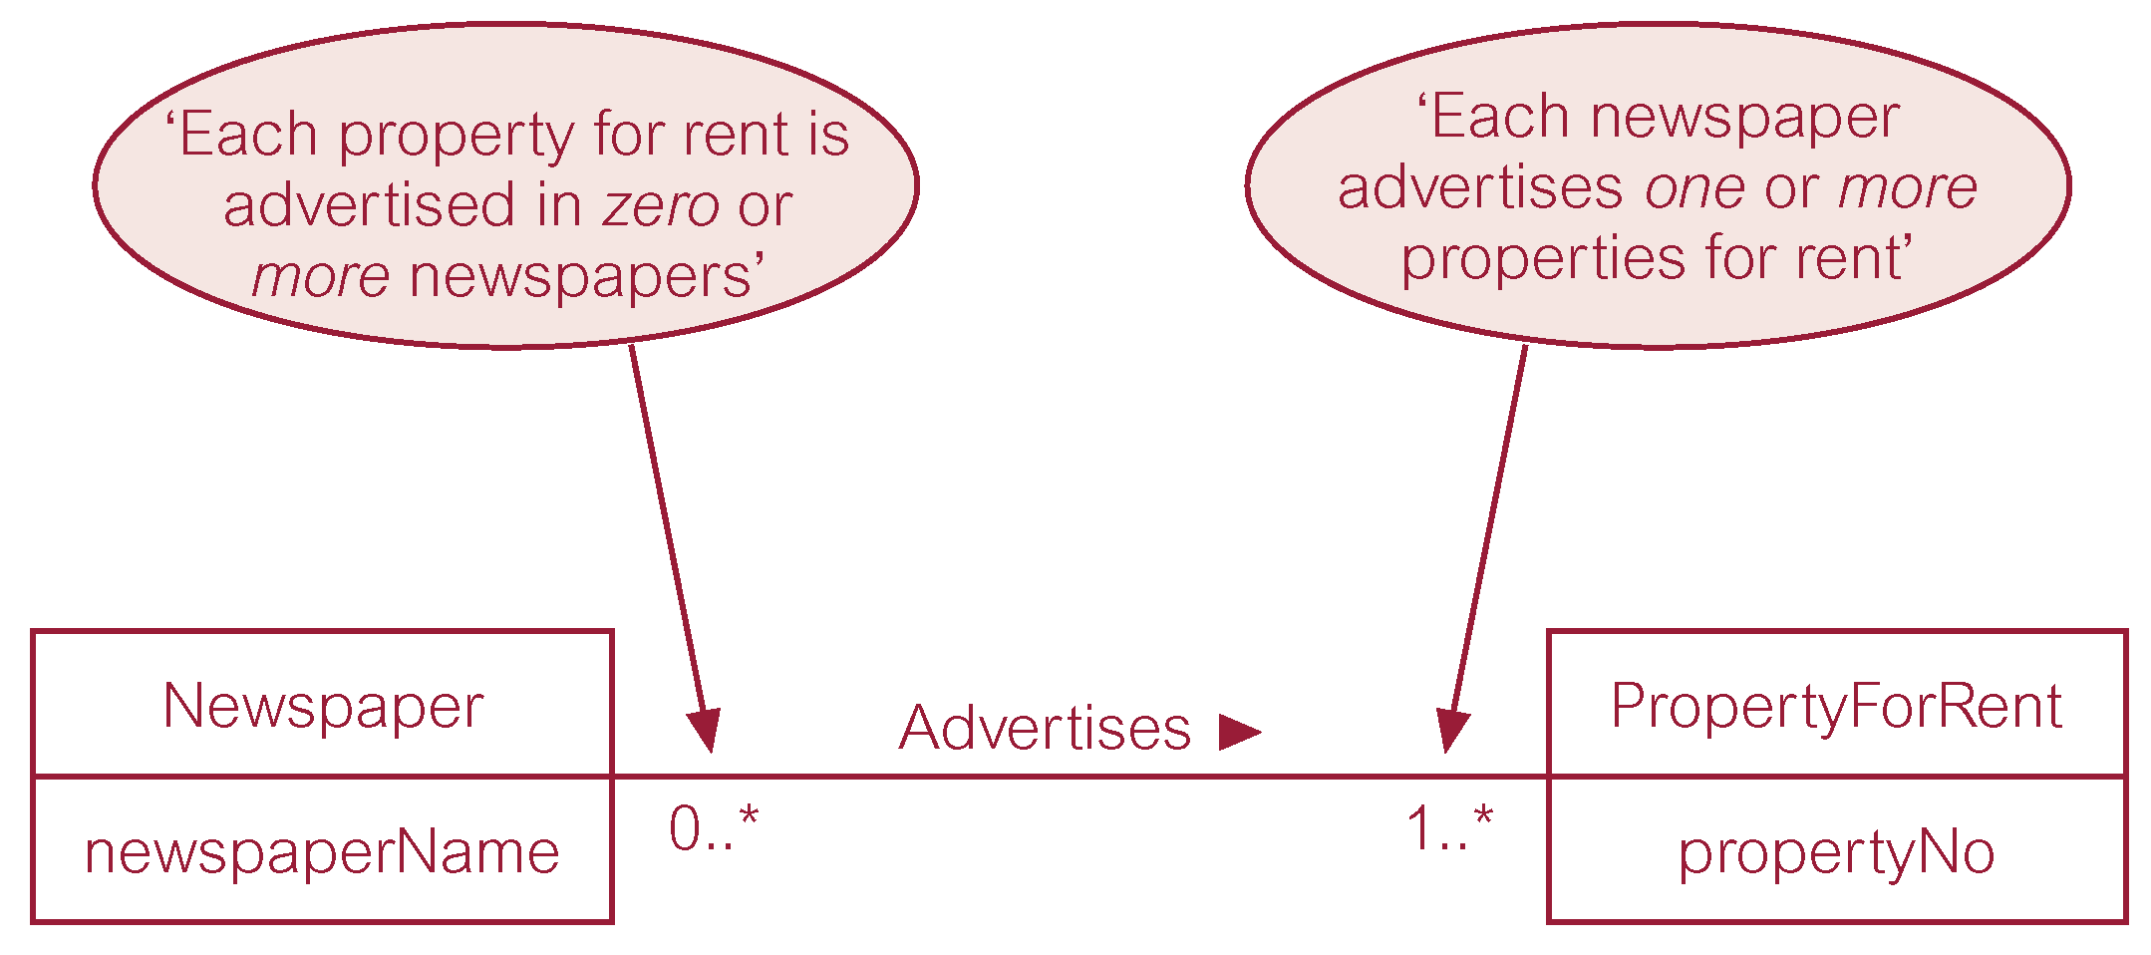
Many-to-many relationship (*:*)

Slide 31
Summary
Entity | Relationship | Attribute
Type Occurrence | Type Occurrence | Simple Composite
Strong Weak | Degree Multiplicity Cardinality Participation | Single-valued Multi-valued

Slide 32
Reading
T. Connoly Chapter 1, 2, 11,12
N. Elmasri Chapter 1,2, 4
J. Gehrke Chapter 1

